Slide 1







Identifying Emerging skills in the Tech Industry
Liam Batiste
14th May 2024

Slide 2



OUTLINE
Executive Summary
Introduction
Methodology
Results
Visualization – Charts
Dashboard
Discussion
Findings & Implications
Conclusion
Appendix

Slide 3

EXECUTIVE SUMMARY
The Scenario - To keep pace changes in technologies, it is required to perform regular analysis of the developer ecosystem to identify current/future skill requirements.
Proposed Solution - By collecting and analysing wrangled datasets from sources including; Job postings, Training portals and Surveys obtained through API endpoints and web scraping. This will allow for greater understanding of the most in demand skill sets for programmers this would facilitate impactful insights by answer the following:
What are the top programming languages in demand?
What are the top database skills in demand?
What are the key demographics of developers?
Processes - Through data collecting and wrangling, exploratory data analysis and visualisation was possible using statistical and explorative data practices including data normalisation, outlier detection, aggregation and visualisation to help provide impactful and actionable insights into the future skills development of Technologists within different disciplines.
The opportunities - This insight can help guide resource allocation, training initiatives, and hiring strategies to stay competitive in the rapidly evolving IT landscape. Further resulting in organisations being able to identify areas of growth and investment to stay ahead of the curve in a rapidly evolving tech industry.

Slide 4

INTRODUCTION
Data was obtained using an API to ddetermine the number of jobs currently open for various technologies and for various locations. This involved retrieving jobs based on their:
Location
Technologies (programming languages and DQLs).
Further data was retrieved through web scraping tabular data based on average annual salary for different technologies.

Slide 5

METHODOLOGY
Data collection – Data was obtained through web scraping and API endpoints, which included Technologies used in industry along with characteristics of the Developer that used such technologies.
Data Preparation – Data exploration of the data set was performed using the Pandas Library to gain understanding of its format. Data Wrangling was then utilized to identify duplicates, find missing values, impute missing values and normalize data for later comparison.
Exploratory Data Analysis – The converted to dataframes from a CSV format to allow for the distribution of key data points to be assessed. Further exploration through descriptive statistics, aggregation and outlier detection and correlation matrix analysis for the Age of developers.
Data Visualization – Data was then queried using SQL from a data warehouse. Data including the compensation of Developers, age of developers, Work hours by age and compensation by age. Additionally, a dashboard was created using the same dataset that gained insight into the current technologist landscape, more specifically looking at the current and future Languages/Databases used by Developer in industry.

Slide 6
RESULTS
Python visualizations
The distribution of compensation for developers was skewed right, and unimodal, with a modal salary of approximately $21,000.
A strong positive correlation for the compensation developers receive against ages was found.
A clear majority of the respondents for the dataset were developers by profession.
Currently used technologies
JavaScript, HTML/CSS and SQL were amongst the top 3 currently used languages.
MySQL, Microsoft SQL Servers and PostgreSQL were amongst the top 3 currently used databases.
JQuery, React.js and Angular were amongst the top 3 currently used Web Frames.
Future technologies
JavaScript, HTML/CSS and Python were amongst the top 3 languages to be learnt next year.
PostgreSQL, MongoDB, and Redis were amongst the top 3 Databases to be learn next year.
React.js, Vue.js and Angular were amongst the top 3 Web Frames to be learnt next year.
Demographics
An expected majority of the respondents were male (93.5%), with the mainstream of which having a Bachelor’s Degree, from a wide variety of countries and a modal age of 28 years.

Slide 7
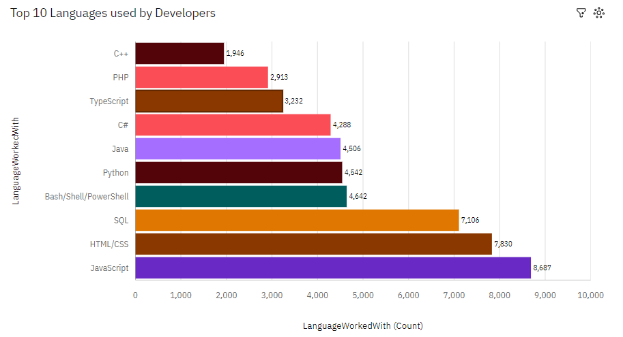
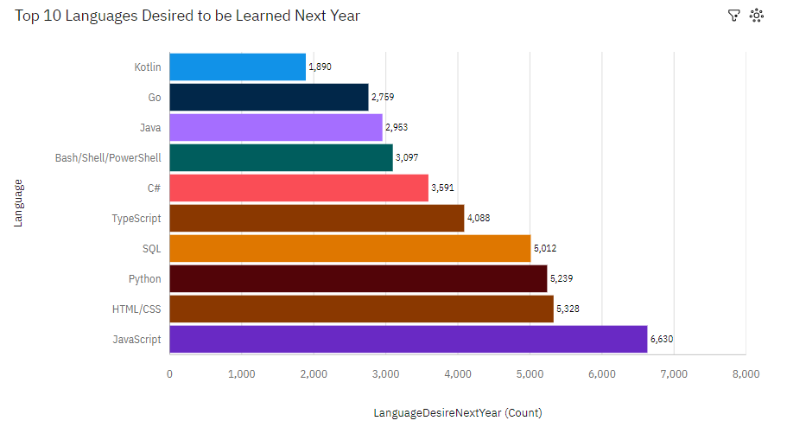
PROGRAMMING LANGUAGE TRENDS
Current Year
Next Year

Slide 8
PROGRAMMING LANGUAGE TRENDS - FINDINGS & IMPLICATIONS
Findings
There is an anticipated increase in the use of Python both compared to the current year and in the coming year.
JavaScript is currently the top programming language and is expected to remain so in the upcoming year for developers.
Languages such as Go and Kotlin are among the top 10 future languages to learn next year.
Implications
Python may see increased demand over time and might be crucial for the career development of many developers in the industry.
Front-end development skills will remain highly sought after by both developers and recruiters in the future.
There appears to be a transition towards more modern programming languages in the near future

Slide 9
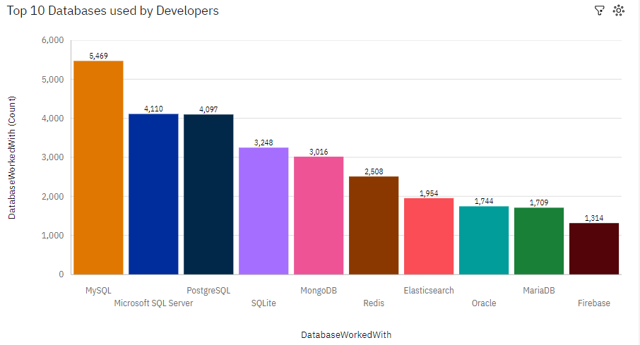
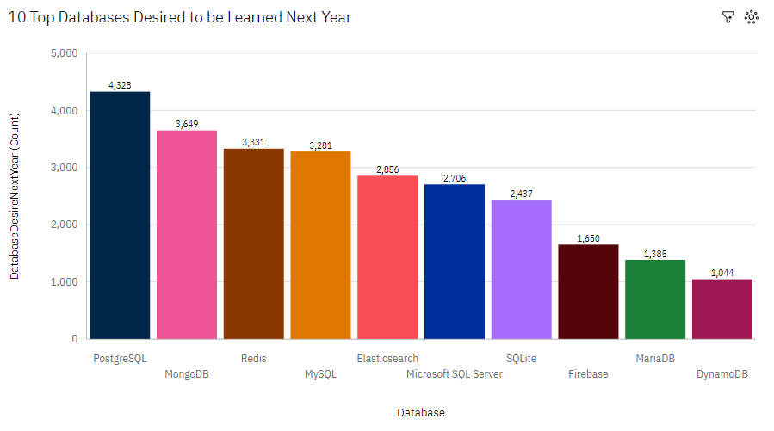
DATABASE TRENDS
Current Year
Next Year
< Bar chart of top 10 databases for the current year goes here >
< Bar chart of top 10 databases for the next year goes here.>

Slide 10
DATABASE TRENDS - FINDINGS & IMPLICATIONS
Findings
There appears to be a shift towards the use of MongoDB and Redis by Developers soon.
PostgreSQL has the highest count for databases to be learnt next year, replacing the current highest MySQL.
A more even spread of databases desired to be learnt next year can be seen, compared to a 3 more ‘dominant’ databases in the current year.
Implications
A shift towards databases that are more flexible and more accommodating for ‘big data’ is expected in the near future.
Developers are predominantly desiring to learn PostgreSQL next year, which differs from this year's most in use database of MySQL.
Developers are seeking to learn a more diverse array of databases in the coming year.

Slide 11

DASHBOARD
https://github.com/LiamBatiste/IBM-Capstone-Cognos?tab=readme-ov-file

Slide 12
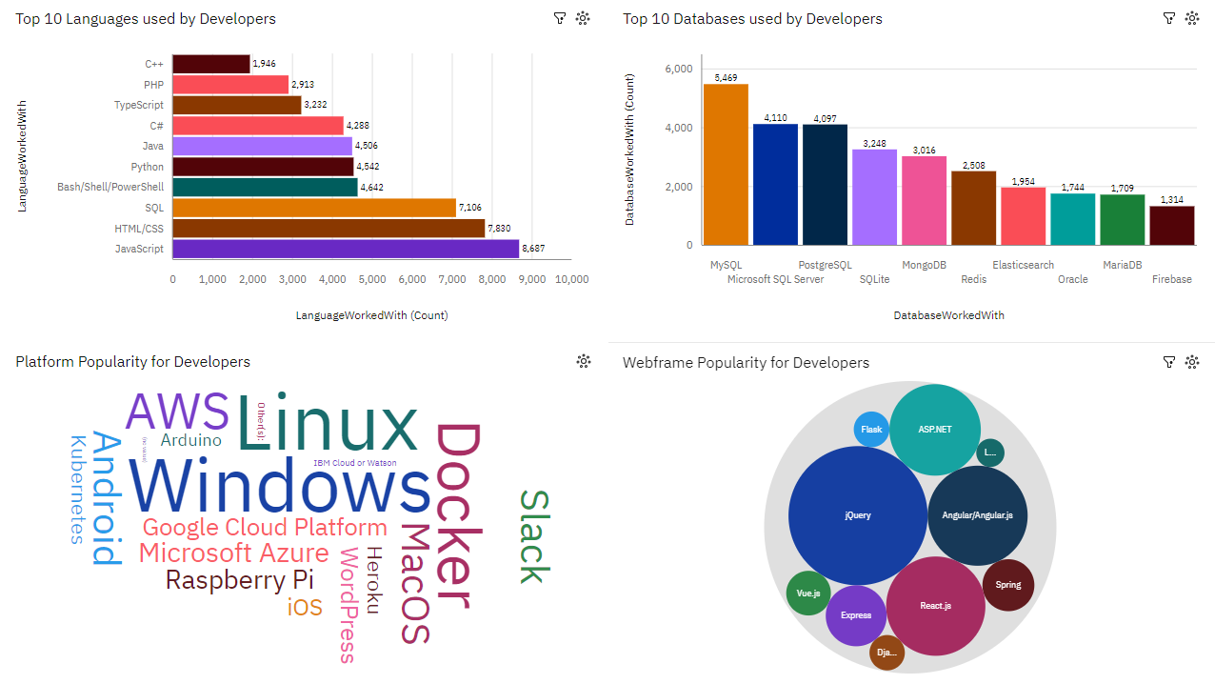
DASHBOARD – Current Technology Usage

Slide 13
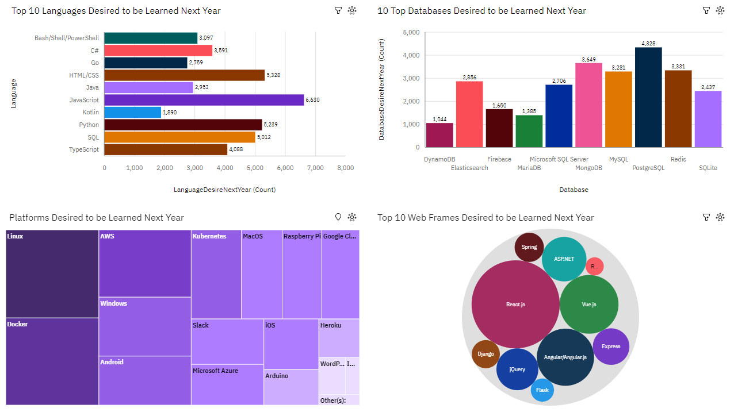
DASHBOARD – Future Technology Trend

Slide 14
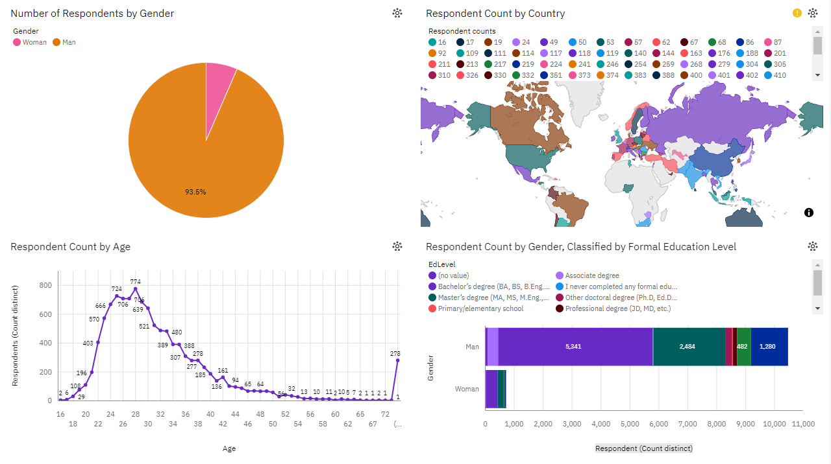
DASHBOARD TAB 3

Slide 15
OVERALL FINDINGS & IMPLICATIONS
Findings
Languages – There a consistent desire by developers for front end development languages, but also increased emphasis on emerging programming languages.
Databases – Databases such as MongoDB and Redis along with PostgreSQL appear to be more desired by developer in the near future.
Implications
Languages – Front end development languages will continue to stay at the forefront of developer skillsets, along with newer languages such as Python and Go and Kotlin.
Databases – Developers are seeking to learn a more diverse array of databases in the coming year, with a particular focus on databases that accommodate ‘big data’.

Slide 16

CONCLUSION
A shift in both languages and databases desired by developers is apparent for next year. Both of which may lead to developers seeking a more diverse spread of modern languages and databases accommodating for better performance and big data respectively.
Conversely, front end development tools such as JavaScript and HTML/CSS seems to be steadily increasing with respect to it’s desirability by developers, evidencing they are ‘here to stay’.

Slide 17

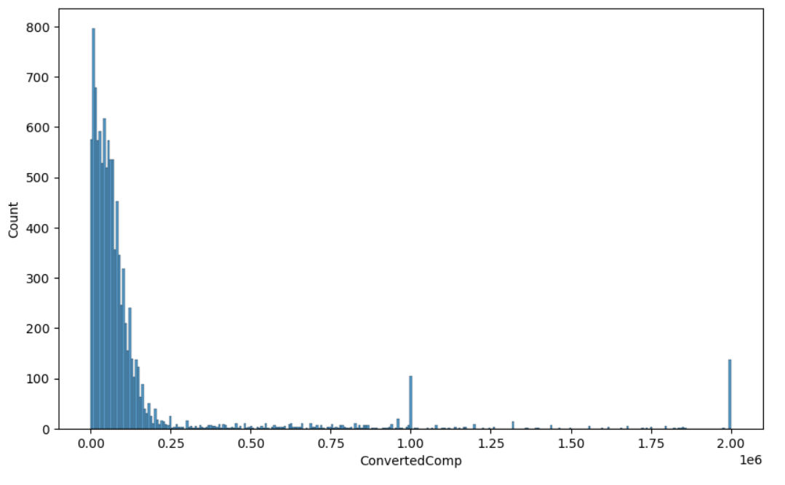
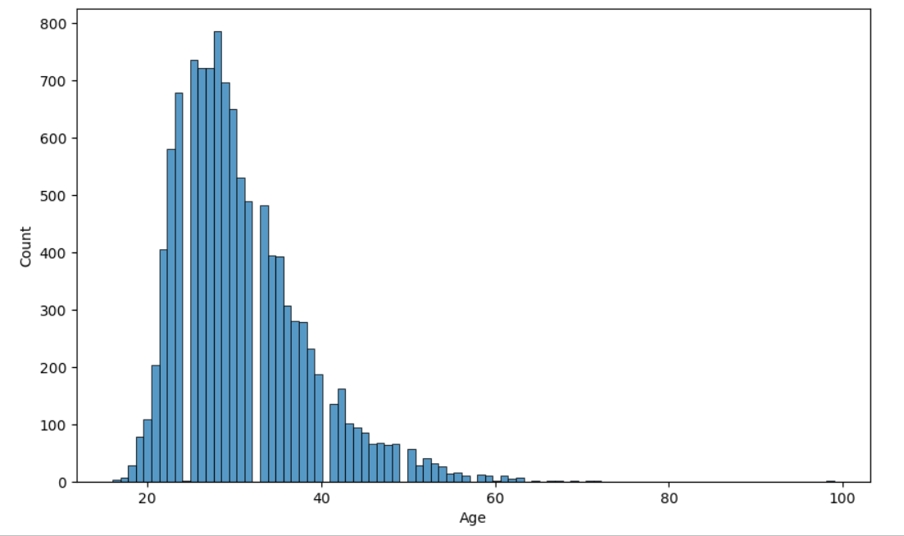
APPENDIX
Fig 1. Count of respondent Compensation ($) for developers.
Fig 2. Count of respondent age for developers.

Slide 18
POPULAR LANGUAGES

